Slide 1
Capstone 3
Final Report

Slide 2


The $64 million Question
Can transfer learning from FastAi CNN models be used to learn to predict price movements in financial markets, based on chart patterns?

Slide 3



The how
I have been accumulating price data on hundreds of different assets for trading purposes, from a variety of sources.
http://rapidapi.com is very helpful for anybody wishing to do the same.

Slide 4
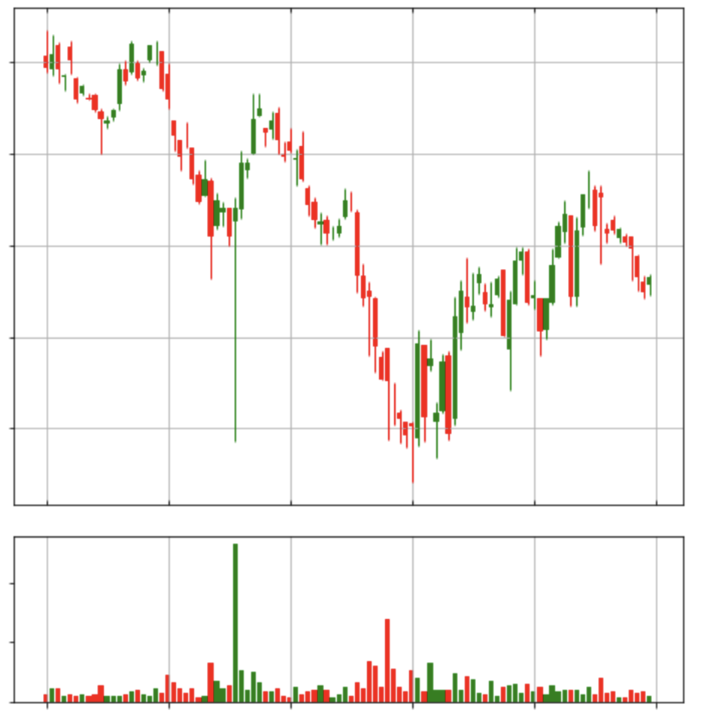


The how
I took the Open, High, Low, Close and Volume data and programmatically transformed them into candle charts as shown on the left.

Slide 5
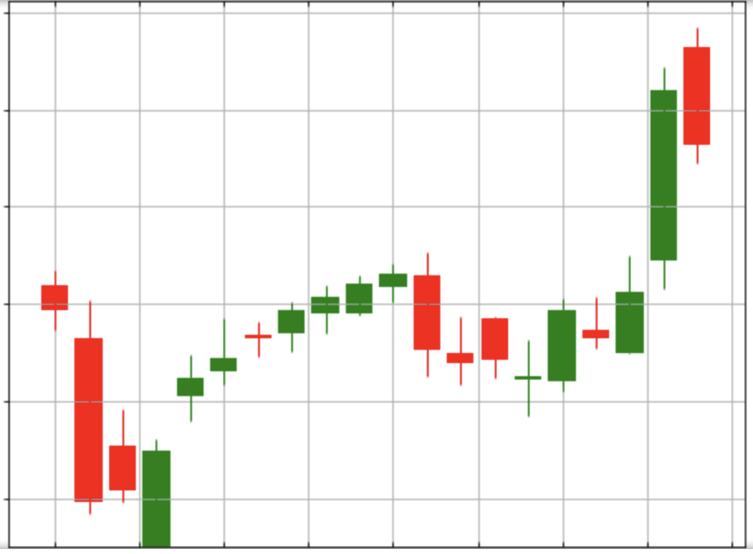
Feature engineering
I then used an algorithm to search for substantial price moves up or down, and saved a chart of the preceeding 20 candle bars for each instance.
I generated about 30,000 features in total, with some variations in size of price moves and timeframes.

Slide 6
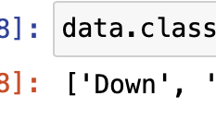

training
I imported a pre-trained FastAi CNN model, and had it learn to classify the charts as either up or down.
I trained two models, each on a different quality of image.
As I had so many features, training took a very long time!

Slide 7
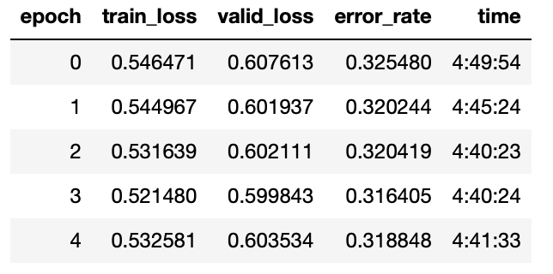
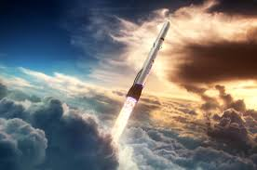
Results
The effort was worthwhile – the best model’s accuracy increased to nearly 70% over about 20 epochs.

Slide 8
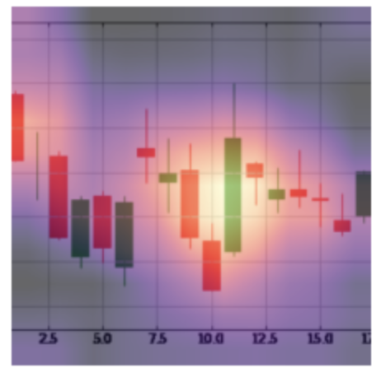
Callbacks
FastAi’s callback functionality enables visual analysis of areas in the charts the model considers to have predictive properties.

Slide 9
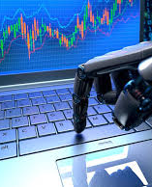
Next steps
Trade!!

